Slide 1

Direct lending platform | Problem Solution | Tech stack | Test the mobile app pilot! | Communities on Meritt | Roadmap and team | Whitepaper Github | Blog, medias, & roadshows | MTT, the Meritt coin
Landing page regardless of screen size
Invisible menu link to
meritt.co/mtt
Put this section in menu but in same colour as background
ACCESS INSTANT UNSECURED LOANS¹
INVEST at
SUPERIOR RETURNS²
DIRECT LENDING PLATFORM
BIGDATASELF | A.I. SCORINGS | BLOCKCHAIN SERVICING
1:Borrow responsibly
2:Capital at risk
Login or join our whitelist
Notes:
OPEN FOR SELF-GOVERNED CREATION AND DISTRIBUTION
OF COMPLEX TOKENS ON THE BLOCKCHAIN

Slide 2
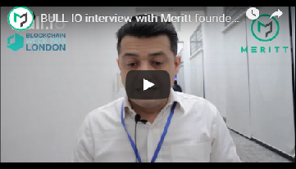








“BUILD & MANAGE YOUR
BIGDATASELF AND
ACCESS CREDIT SCORINGS AND LOANS THAT BANKS WON’T DO!”
Alignment
Meritt is a direct lending platform enabling individuals & businesses to harness their everyday data to have better access to finance
Menu link to here
New
addition
Instant & easy
Low cost & Automated
Compliant
Local platforms
Safe & secure
Transparent
Bespoke
Consent based
Thin file scoring
Notes:
OPEN FOR SELF-GOVERNED CREATION AND DISTRIBUTION
OF COMPLEX TOKENS ON THE BLOCKCHAIN

Slide 3
Inefficient financial intermediation & increasing credit gap
Many good businesses and creditworthy individuals cannot get a loan. The World bank estimates the global credit gap at US$2.6 trillion for small businesses in 2012
Record amount of savings and capital are seeking safe and transparent investment across sectors & geographies
Cost of delivering the full credit chain is too high on most loan applications for existing lenders, banks also have limited capital to deploy and limited reach
Existing lenders only use a incomplete set of data to assess credit risks and are not trusted with storage of personal data
REPLACE OLD PAGE
Meritt improves funding prospects by delivering low cost and secure credit chains
Identification documentation
Credit Risk analysis
UX - User experience
Loan funding
Loan servicing
Automated read only from personal & authenticated Dataself vault
Straightforward self-issuance of loan tokens on Marketplace for matching with investors
Low cost smart contracts servicing on the blockchain
Automated A.I. scorings

Slide 4
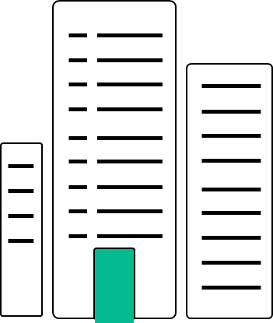

$5 trillion financing gap despite ubiquitous data!
Existing lenders are out of reach and expensive for many. They are also blind to alternative datasets …
Compliance
NEW PAGE
Problem/Solution
Admin
Individuals, Businesses
Institutional lenders
Retail investors
Manual risk analysis
Paper data
…resulting in missed opportunities for investors and for creditworthy individuals and businesses
Alignment
All
In
One
screen
Investors on Meritt access superior risk adjusted returns with
end-to-end digital lending channels that are secure and low cost
Identification
KYC documentation
Credit Risk analysis
Underwriting
UX - User experience
Loan funding
Loan servicing
CHANGE
Automated read
from encrypted
Bigdataself
Automated
A.I. credit Scorings
Straightforward self-issuance of loan tokens for matching with investors on Marketplace
Low cost & transparent smart contracts servicing on the Meritt blockchain
Notes:
65 million enterprises, or 40 percent of formal MSMEs in emerging and developing economies, lack access to credit.
https://www.jbs.cam.ac.uk/fileadmin/user_upload/research/centres/alternative-finance/downloads/2019-early-lessons-regulatory-innovations-enable-inclusive-fintech.pdf
https://www.smefinanceforum.org/data-sites/msme-finance-gap
06 16 07 10 39 Mr MERIC
Jacquiot

Slide 5

The Meritt direct lending platform has 3 key technology stacks
Businesses, Individuals
1. BIGDATASELF
Free service to build & manage own digital footprint on unique encrypted private repository. Support any structured data such as banking, mobile and online transactions.
Alignment
Learn more
2. A.I.CREDIT SCORINGS
All
In
One
screen
Models trained with Machine Learning algorithms using Bigdataselfs and other public and private data (e.g. PSD2) for continuous automated underwriting.
Learn more
3. BLOCKCHAIN SERVICING & MARKETPLACE
Simple self-issuance of authenticated loan tokens on marketplace for requesting finance. Automated & low cost smart contract servicing on matching with investors.
Investors, Lenders
Learn more
Notes:
By acting as an information-sharing mechanism and providing a universal source of truth that is tamper-proof and distributed, blockchain could lead to increased efficiency and improvements, including establishing a level of accountability and transparency that hitherto was impossible; reducing human error, fraud, data duplication, processing delays, and transaction costs; and providing easier and improved data access to both internal and external parties. Moreover, with the potential to create reliable decentralized databases, give people control over their data, and create borderless, immutable financial identities, blockchain could have a considerable effect on emerging customers and financial inclusion. That being said, blockchain is unlikely to have a significant impact on emerging customers in the near or medium term.
https://www.european-microfinance.org/sites/default/files/document/file/Accelerating_Financial_Incusion_with_New_Data_-_FINAL.pdf

Slide 6
Key innovation
Bigdataself is a free online service that enables individuals and businesses to securely build and manage their digital footprints. Any structured data such as online or banking transactions, e-shopping payments (Ebay, Amazon, Paypal), mobile & social media transactions or utility bill payments can be recorded on this self-sovereign private repository. Bigdataself are encrypted and used to provide structured data for credit scorings. Ownership, control and level of disclosure of Bigdataselfs remain exclusively with users at all time.
Technology
Data storage combining data from multiple sources and operated through a consent architecture on local or distributed storages for users to store and share encrypted data without reliance on a third-party storage provider (e.g.IPFS). Allows the owner to provide highly granular access to the data, including zero knowledge access. No data held by Meritt. Users retain full control and ownership of encrypted Bigdataself.
Key innovation & technology
Credit scoring & pricing model trained with Machine Learning algorithms using in real time a combination of financial data disclosed by users from their Bigdataselfs and other available data from 3rd parties whether public or private (e.g. banking data via PSD2 APIs, accounting data via software APIs,) for continuous automated underwriting. The big picture credit scorings include multiple dimensions such as spending or cash flow patterns, available collateral valuation and strength of personal guarantee. It also covers thin file clients by leveraging available alternative data.
ALL
Text change POP UP BOXES
Key innovation
Simple self-issuance of authenticated loan tokens on marketplace for requesting finance. Investors on the marketplace select loan tokens according to their chosen risk/return profile & geography. On matching with investors the loan is serviced automatically with dedicated smart contracts for each loan.
Technology
Blockchain platform marketplace. Open APIs for users to invoke a factory smart contract that deploys for each loan request unique & non fungible set of loan tokens and servicing smart contracts.

Slide 7
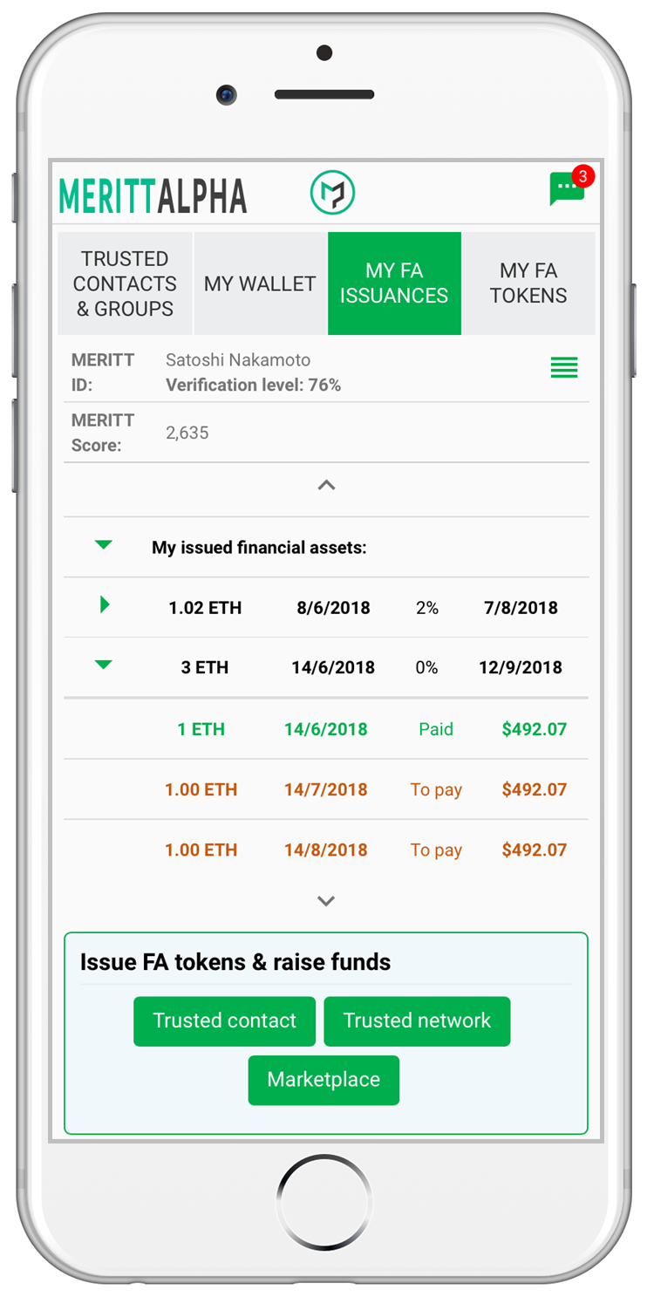

Build your authenticated financial dataself,
access credit scorings and issue your blockchain loan tokens on the marketplace to request credit finance
The Alpha app is a pilot built for small business loans and consumers loans in the EU
Alpha score based on transparent cash flow analysis with your bank transactions saved on your financial dataself vault via PSD2 APIs
With your portable Alpha credit score, issue your unique set of ERC20 loan tokens for each loan request
Trustless verification of issuer ID, loan tokens score and repayment terms on public & private ledgers
Loan tokens are tradable
Try the testnet dApp !
OLD PAGE
Existing Link to
Meritt Dapp
See next page
Learn more on the Meritt dApp

Slide 8
Try the mobile application pilot on the test network !
Businesses, Individuals
To request unsecured loans:
Build your Bigdataself
Request credit scorings
Issue your authenticated blockchain loan tokens on the marketplace
Existing Link to
Meritt Dapp
Investors, Lenders
To invest and lend :
Select your risk/return profile & geography
Select individual or portfolios loan tokens
Liquid secondary market with tradable loan tokens
All
In
One
screen
Learn more on the Meritt dApp

Slide 9

Learn more page 1
Build your Bigdataself and
issue loan tokens to request finance
formatting
SAME PAGE
Available building blocks for your verifiable loan token
Loan token building blocks
3.
5. Token terms, public or private on explorer?
1.
Loan token trading: public or private ?
Hover on the blocks to
learn how they work!
6.
Authenticated Bigdataself
2.
Repayments to loan token buyers (Lenders)
Text change in red
3.
Voting or communication
with token holders ?
& dataself
4. Token distribution: private off-chain or public on-chain ?
Notes:
5) Slide works and makes sense, but the copy is complex and you focus on the features of the protocol, not the benefits of the protocol. It’s also worth describing here how what you’re doing solves the problems previously identified.

Slide 10
Text change in red
Hover text
Text changes
1. Meritt loan tokens are compliant with the ERC20 standard setting the basis for token transfers and splits, Transfer can be restricted to a closed user group and temporarily suspended (token can be frozen)
2. Any repayments from the loan token issuer to the pool of lenders is automatically transferred to the relevant wallets where the loan tokens are being held. The distribution respects the pro rata distribution of the underlying asset (i.e. the loan tokens).
3. Two-way information channel on the blockchain: (i) loan token issuer can broadcast important messages or notification through the smart contract to all Lenders to comply with information undertakings under the loan agreement (ii) Lenders can send messages to the issuer when the contract requires (e.g. notice in certain cases like exercise of an option for a convertible note). Messages can be private with only a hash being submitted to the loan token smart contract to ensure authenticity of the vote.
4. The borrower or entity seeking funds to invoke a factory smart contract that deploys unique loan tokens and servicing smart contracts for each loan.
5. Lenders and observers can query Meritt registers to obtain data about the existence of Meritt loan tokens (to the extent those are public) as well as data on the events associated with each of the loan tokens. Key terms of your loan token such as re-payments schedule & interests on the Meritt ledgers can be queried. Transparency, trustless verification, reliable track record
6. Data storage combining data from multiple sources and operated through a consent architecture on local or distributed storages for users to store and share encrypted data without reliance on a third-party storage provider (e.g.IPFS). Allows the owner to provide highly granular access to the data, including zero knowledge access. No data held by Meritt. Users retain full control and ownership of encrypted Bigdataself.

Slide 11
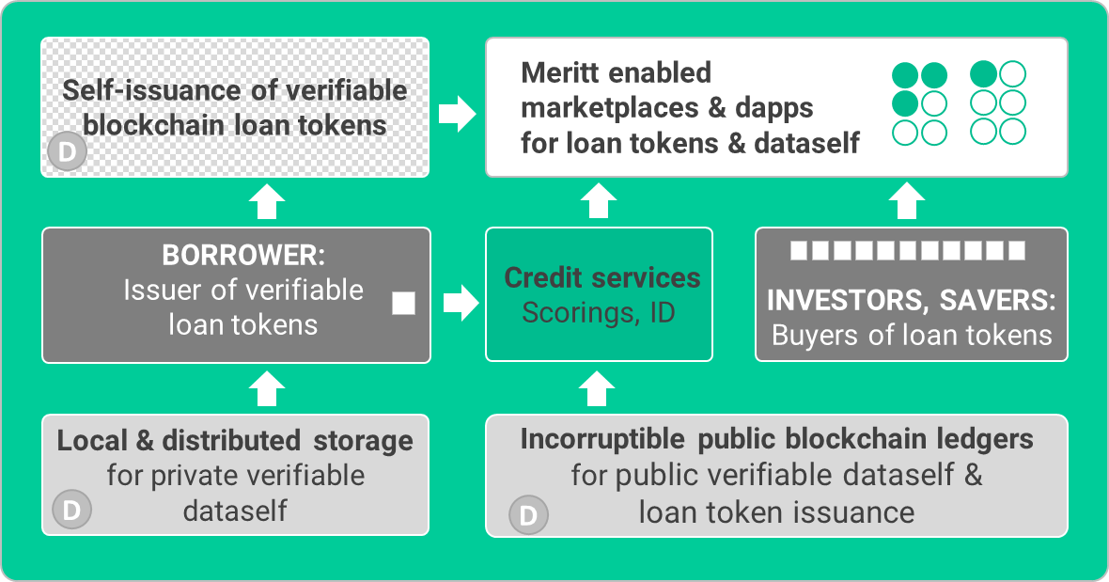
Learn more page 2
How the Meritt dApp works
Hover on the blocks to learn how they work!
Meritt decentralised application
SAME PAGE
dApp crypto wallet and social media (Front end interface)
Alpha Marketplace
Bilateral
Tokens
Trusted community
Tokens
Meritt Alpha scoring
Unsecured issuance
Asset managers framework
Trusted social network
framework
Meritt tools
Custodian (Private key management)
Escrow smart contract (Secured issuance)
MERITT BLOCKCHAIN PLATFORM
3rd party Blockchains
RSK Bitcoin / Ethereum
Loan token issuance +
Dataself
3rd party distributed storage
IPFS/ BDB
+
+
PROTOCOL
as sidechains

Slide 12
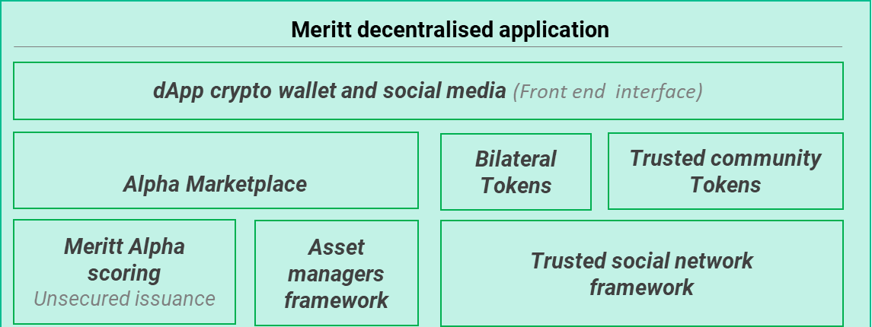
Hover text changes:
Decentralised crypto wallet and social media application optimised for mobile use. Interface for participants to create or join trusted networks. dApp also used for loan token issuance and loan token purchase on the Alpha marketplace
The marketplace ensures investors’ demand in decentralised token issuance. Matching of investors/lenders and loan token issuers. Investors/Lenders can fund loan token issuances based on the issuers’ Alpha score (unsecured ) or the type of collateral in on-chain or off-chain escrow (secured)
Bilateral contracts are a closed community between 2 entities like friends or family members. No need for any external intermediaries, scoring or ID. Messaging allows direct negotiation of bilateral agreements
Community tool. For self-crowdfunding directly with your existing trusted contacts when no scoring or ID is required within a trusted community. A community admin can create a private group allowing members to obtain funding from other known and trusted members. Access is restricted to members and tokens are issued and transacted only under the rule set up by the admin for the group.
Lenders & investors can buy a range of loan tokens directly or on a portfolio basis based on scorings & yield. Loan token Issuer access peer-to-peers funding on the marketplace by and disclosing their score and listing their loan tokens
Text change in red
Credit scoring model trained with Machine Learning algorithms using in real time a combination of financial data disclosed by users from their Bigdataselfs and other available data from 3rd parties whether public or private (e.g. banking data via PSD2 APIs, accounting data via software APIs,) for continuous automated underwriting. The big picture credit scorings include multiple dimensions such as spending or cash flow patterns, available collateral valuation and strength of personal guarantee. It also covers thin file clients by leveraging available alternative data.

Slide 13
Secure proof of Authority Blockchain platform
Learn more page 3
Decentralised, scalable and low cost blockchain platform
SAME PAGE
No change
Meritt platform – Logic flow
Self-issuance of verifiable
blockchain loan tokens
Meritt marketplaces
for loan tokens
BORROWER
Credit
scorings
INVESTORS, SAVERS:
Buyers of loan tokens
Text change in red
BIGDATASELF
Meritt Blockchain platform
For issuance of servicing of authenticated loan tokens
Back

Slide 14
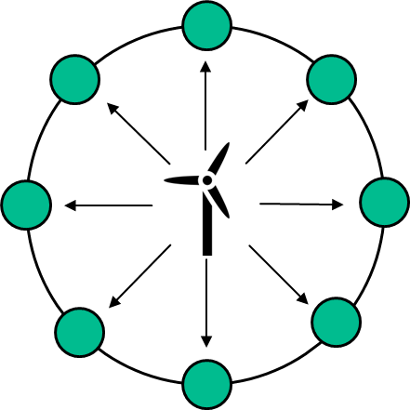
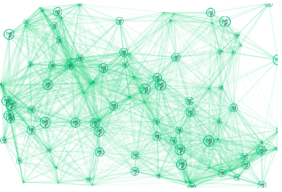
How Meritt can also be a useful tool for communities ?
1. For self-crowdfunding directly with your existing trusted contacts
Round
edges
Communities
Build your group on the Meritt social network or
connect your community app via the open APIs
SAME PAGE
NO CHANGE
Typo
Community admin:
self-issue & sell loan/donation tokens to trusted group members
Community members:
Support and participate in your trusted network token issuance
All
In
One
screen
Alignment
2. For Tokenisation via open APIs to operate on the transparent Meritt ledger
The Hummingbird Nation charity uses Meritt token issuance APIs to tokenise donations it receives.
By doing so, donors can track where and how their donations are being spent on the verifiable and transparent Meritt Blockchain Ledger.

Slide 15
Roadmap – key milestones
Text change in red
SAME PAGE
Remove “protocol”
Text changes in red
Launch, white paper, source code
Meritt protocol v0 tested on the Ethereum Rinkeby testnet.
Meritt
Scoring v0
Meritt on testnet RSK
Bitcoin
Feb. 2018
Jul. 2018
Q3. 2019
Q4. 2019
Sept. 2017
May 2018
Q2. 2019
Q4. 2019
Meritt protocol smart contract library development
Web progressive alpha dApp on testnet, integrating light wallet and loan token issuance
Native apps for iOS and Android Main-net release
Stable coins integration
Detailed roadmap
Meritt

Slide 16
Detailed roadmap
Sep 2017 | ● | Launch
Q4 2017 | ● | Website, white paper, source code
Q1 2018 | ● | Protocol smart contract development, Meritt front end wireframe design
Q2 2018 | ● | Meritt protocol v0 on Ethereum Rinkeby testnet
Q2 2018 | ● | Protocol integration with Meritt front end
Q3 2018 | ● | Meritt web progressive dapp released, integrating light wallet and loan token issuance
Q4 2018 | ● | Meritt Marketplace and community framework – alpha version (Utility tokens and loans)
Q2 2019 | ● | Meritt underwriting and scoring - module v0
Q3 2019 | ● | Meritt protocol v0.1 on Ethereum mainnet
Q3 2019 | ● | Native apps for iOS and Android
Q4 2019 | ● | Meritt on testnet RSK Bitcoin
Q4 2019 | ● | Meritt Marketplace v0.1 (portfolio invest function enabled)
Q4 2019 | ● | Community framework v0.1 (group and trusted network function)
Q4 2019 | ● | Whisper client chat integration (i.e. Ethereum P2P messaging)
Q4 2019 | ● | Escrow smart contract for on-chain collateral deployed - secured token issuance
Q4 2019 | ● | Meritt underwriting and scoring v0.1 (processing data over distributed storage)
Q4 2019 | ● | Stablecoin integration
Text change in red
All
In
One
screen
Table & Text changes
Removed lines
Roadmap remains subject to changes
Back to Roadmap

Slide 17












Experienced team based in London with coverage in Asia
Meritt leads
SAME PAGE
Hicham Errafass
Structured finance
GE Capital, ESCP Europe
Rayan Goutay
Regulatory officer, FCA, Goldman Sachs, Panthéon Sorbonne
Tom Ku
Asia Manager, Citibank, E&Y
Columbia business school
Jay Best
AI & Blockchain specialist,
Cogni capital, MIT
Developers
Alignment
Stefan Loesch
Blockchain architect
Cryptocustodian, Insead
Bilal Arif
Lead developer, Full stack & solidity developer
Muhammad Khan
Blockchain Engineer
COMSATS University
Danish Saber
DApp Developer
COMSATS University
Community managers, marketing, IT
Dan Eve
Crypto community engagement.
cryptocurrency miner, investor
Candice Morris
Charities & trusted communities engagement
Adrian Slusher
Marketing & digital media
Scotia bank
Lina Kim
Asia coverage
Crypto community

Slide 18








Shireen Sivan
Research analyst
University of Sheffield
Philip Leipper
Computer science teacher
King’s college London
SAME PAGE
Advisors
Eric Alexandre Ceret
Founder Jetcoin institute
Lidia Carmina Dumitrascu
CEO Ventureboost LTD
Filipe Alves Moura
Senior Corda developer
Nth CEO
Demetrios Zamboglou
Director - Lykke exchange
Jineshwar Kochar
Fintech analyst
Jan Bolhuis
Blockchain architect

Slide 19

Whitepaper
REQUEST WHITE PAPER
SAME PAGE
REGISTER YOUR INTEREST
JOIN OUR WHITELIST
Subscribe to our newsletter
Your email
SUBSCRIBE
Check our Github repo

Slide 20






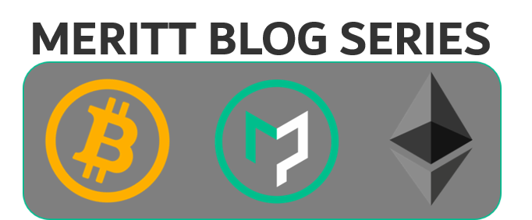




Partners
SAME PAGE
Medium blog
Roadshows & Media Coverage

Slide 21
Medium blog
Roadshows & Media Coverage

Slide 22

SAME PAGE
text change
Meritt is a direct lending platform that enables individuals and businesses to harness their everyday data to instantly access unsecured loans. By leveraging alternative datasets, the Meritt platform offers new investment opportunities to lenders while at the same time delivering superior risk adjusted returns with a fully automated low-cost digital lending platform.
Individuals and businesses, build your Bigdataself and easily access scorings and loans that banks won’t do! Investors, select your risk/return profile & geography, and invest in new lending opportunities at superior returns. Visit meritt.co and try now the pilot application from your mobile.
Despite ubiquitous data there is still $5 trillion of unmet financing needs. Existing lenders are out of reach and expensive for many, they are also blind to alternative datasets. Meritt’s ambition is to fill this gap with a new platform combining three key technology stacks: Bigdataself, A.I. scorings and Blockchain servicing.
Bigdataself enables users to build and manage their own digital footprint on a unique and encrypted private repository. Bigdataself supports any structured data such as banking, mobile and online transactions but also e-shopping transactions (Ebay, Amazon, Paypal), mobile and social media transactions.
Meritt users have access to credit scorings which are models trained with Machine Learning algorithms using data disclosed from Bigdataselfs and other public and private data (e.g. PSD2) for continuous automated underwriting.
Once issued with a scoring, users seeking finance can self-issue authenticated loan tokens on the marketplace. On matching with investors, the servicing of the loan is automated by smart contracts on the Meritt Blockchain platform.
Meritt is also working with the Hummingbird Nation charity which uses Meritt token issuance APIs to tokenise FIAT donations it receives so that donors can track on a verifiable Ledger where and how their donations are being spent.
Participants are ultimately responsible for review and approval of the terms and conditions of a particular loan issued by a peer on Meritt and of the risks associated. No guarantee is provided by Meritt. Terms of website use

Slide 23
New link:
www.meritt.co/mtt
Content for
www.meritt.co/mtt

Slide 24
MTT is the Meritt coin
A small deposit in MTT is required to request credit finance and issue loan tokens on the loan marketplace
SAME PAGE
Issuer of loan tokens / Borrowers
Entity seeking funding
Small business, individuals
Community administrator
Buyer of loan tokens / Investors
Funds, banks, investors,
Supporting community members
Staking deposit of 1% of requested loan amount in MTT
Loan token issuance
MTT Reward to drive network adoption for
early participants only
Funds: BTC , ETH, Fiat
Loan tokens
marketplace
Alignment
MTT is a Low velocity coin accelerating the network adoption. MTT demand increases with network adoption and volume of loan tokens issued
on the protocol

Slide 25
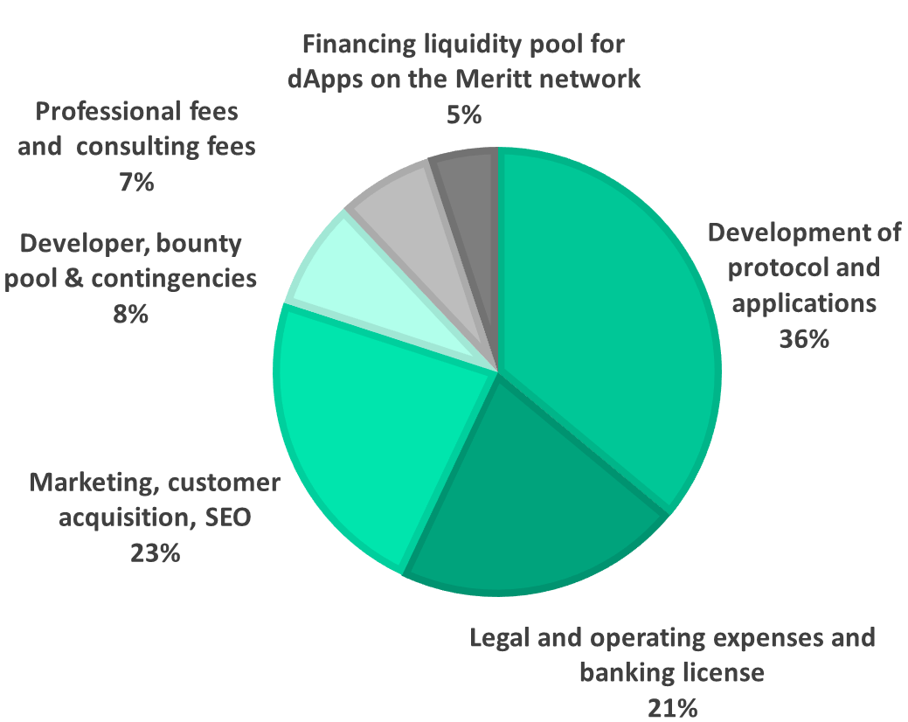
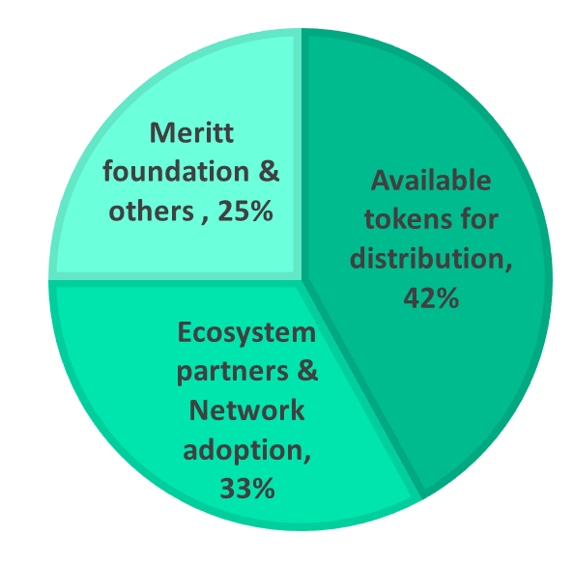
MERITT coin allocation
Token symbol | MTT
Token standard | ERC20
Token supply # | 1,200,000,000
Available tokens for distribution # | 504,000,000
SAME PAGE FROM PREVIOUS WEBSITE
Also available in mobile versions landscape and portrait
Token allocation
Budget allocation
Alignment

